Slide 1

2EC801 major project review 1
Testing & Verification of Open Charge Point Protocol (O.C.P.P.) Modules
Submitted to
asst. prof. rutul patel
assoc. Prof. Sachin gajjar
~By Aum Dhabalia (21bec027)

Slide 2
OUTLINE
Introduction
Literature Survey on OCPP
OCPP Architecture
OCPP Modules
OCPP Message Format
Tools used for OCPP
Conclusion
References

Slide 3
Introduction to oCPP
Open Charge Point Protocol
Offers communication between charging station, charging station management system and electric vehicle (EV).
Open standard where any EV can be charged at any charging station.
Provides functionalities and features like smart charging, ISO-15118 certification, reservation, authorization, security, etc.
Real-time communication

Slide 4
Literature Survey on OCPP
Electric Vehicles are becoming a new mode for transportation, and it has only been possible with a good availability of charging station. Challenge that faced currently is the proprietorship of charging station network.​
To remedy this challenge of proprietorship, in 2009, ElaadNL, an organization of Dutch DSOs (Distribution System Operator) started an open standard communication protocol known as Open Charge Point Protocol (OCPP).​
Proprietary protocols have individual and distinct communication interfaces where flexibility and scalability issues were affecting the EV market growth.​
Unlike these proprietary protocols, OCPP lets EV to charge at any charging station.​
This enhanced growth of EV market to next level enabling vendors to apply openly.​

Slide 5
terminologies
CSMS – Charging Station Management System (Server)
Central server that oversees all the charging stations over its coverage.
CS – Charging Station (Client)
A charge point connected to CSMS through web-socket.
EVSE – Electric Vehicle Supply Equipment
A hardware equipment that supplies power to the EV from the CS
Connector
Electric outlet on a CS
EV – Electric Vehicle

Slide 6
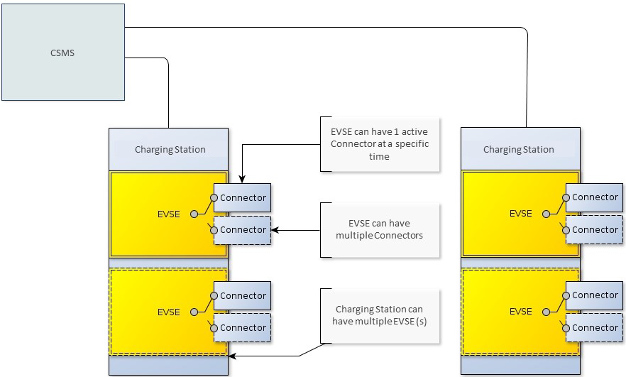
OCPP Architecture

Slide 7
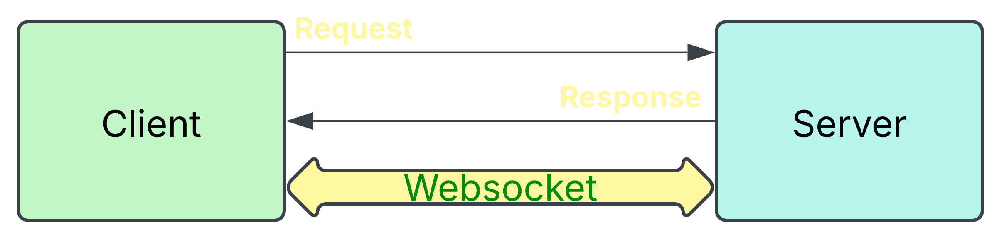
Web-socket
Unlike HTTP protocol which is half-duplex and connection is terminated after session has ended.
Bi-directional, full-duplex protocol used for client-server communication.
Connections stay alive after event has ended.

Slide 8
OCPP 1.6 feature profiles
Core
Firmware Management
Local Auth List Management
Reservation
Smart Charging
Remote Trigger

Slide 9
Core profile
Authorize
Boot Notification
Clear Cache
Change Availability
Change Configuration
Data Transfer
Get Configuration
Heartbeat
Meter Values
Remote Start Transaction
Remote Stop Transaction
Reset
Start Transaction
Stop Transaction
Unlock Connector

Slide 10
Firmware management
Get Diagnostics
Diagnostics Status Notification
Firmware Status Notification
Update Firmware

Slide 11
Local Auth List Management
Get Local List
Send Local List
Reservation
Reserve Now
Cancel Reservation
Remote Trigger
Trigger Message

Slide 12
Smart charging
Set Charging Profile
Clear Charging Profile
Get Composite Schedule

Slide 13
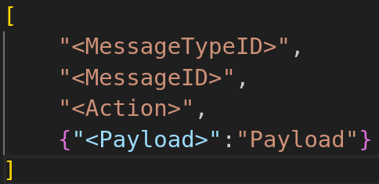
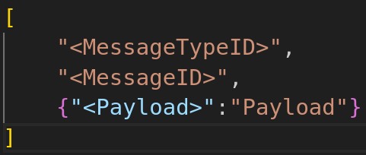
OCPP Message Format
Request
response

Slide 14
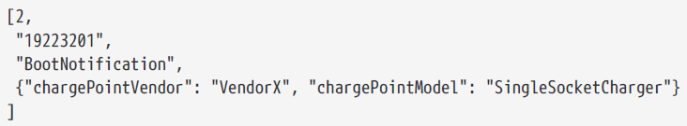
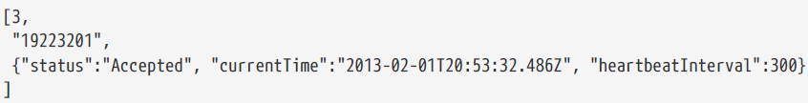
Sample Message for Boot Notification
Request
Response

Slide 15
Tools used for ocpp
Languages : C++ for developing and testing of client. JSON for configuration files and message formats.
OS platform : Linux for developing testing and verification of OCPP client-side.
SteVe server for testing and verification of
Libraries : libocpp by EVerest, websocketpp, nlohmann for JSON parsing

Slide 16
CONCLUSION
Learned about Open Charge Point Protocol
Learned about working of OCPP and its implementation over web-sockets
Learned about web-sockets
OCPP solves issues of proprietorship charging station networks by providing compatibility of charging over any charging stations.
OCPP increases scalability and flexibility of charging stations.

Slide 17
REFRENCES
[1]. Open Charge Alliance, “New in OCPP,” Open Charge Alliance, 2024.
[2]. Open Charge Alliance, "OCPP and Filling Stations" Open Charge Alliance, 2024
[3]. Open Charge Alliance, “OCPP 1.6: Edition 2,” Open Charge Alliance, 2024.
[4]. Open Charge Alliance, “OCPP 1.6: Json Specifications" Open Charge Alliance, 2024​
[5]. Open Charge Alliance, "OCPP vs Proprietary Protocols" Open Charge Alliance, 2024​
[6]. Open Charge Alliance, "Open vs Closed Charging Stations" Open Charge Alliance, 2024

